Slide 1
Final Report | Capstone Project – The Battle of Neighborhoods Finding a Better Place in Indore(M.P.), India
This is the Capstone project of the course applied data science capstoneon Coursera
Created By;- Rishi Joshi

Slide 2
1. Introduction:
The purpose of this Project is to help people in exploring better facilities around their neighborhood. It will help people making smart and efficient decision on selecting great neighborhood out of numbers of other neighborhoods in Indore(M.P.), India
Lots of people are migrating to various states of India and needed lots of research for good housing prices and reputated schools for their children. This project is for those people who are looking for better neighborhoods. For ease of accessing to Cafe, School, Super market, medical shops, grocery shops, mall, theatre, hospital, like minded people, etc.
This Project aim to create an analysis of features for a people migrating to Indore(M.P.) to search a best neighborhood as a comparative analysis between neighborhoods.
It will help people to get awareness of the area and neighborhood before moving to a new city, state, country or place for their work or to start a new fresh life.

Slide 3
2. Data Section:
Data Link: https://indiamapia.com/Indore.html
I will scrape this website to get the latitude and logitude of different places in Indore(M.P.) according to thier pin code
Foursquare API Data: We will need data about different venues in different neighborhoods of that specific borough. In order to gain that information we will use "Foursquare" locational information. Foursquare is a location data provider with information about all manner of venues and events within an area of interest. Such information includes venue names, locations, menus and even photos. As such, the foursquare location platform will be used as the sole data source since all the stated required information can be obtained through the API.
After finding the list of neighborhoods, we then connect to the Foursquare API to gather information about venues inside each and every neighborhood. For each neighborhood, we have chosen the radius to be 500 meter.

Slide 4
The data retrieved from Foursquare contained information of venues within a specified distance of the longitude and latitude of the postcodes. The information obtained per venue as follows:
Neighborhood
Neighborhood Latitude
Neighborhood Longitude
Venue
Name of the venue e.g. the name of a store or restaurant
Venue Latitude
Venue Longitude
Venue Category

Slide 5
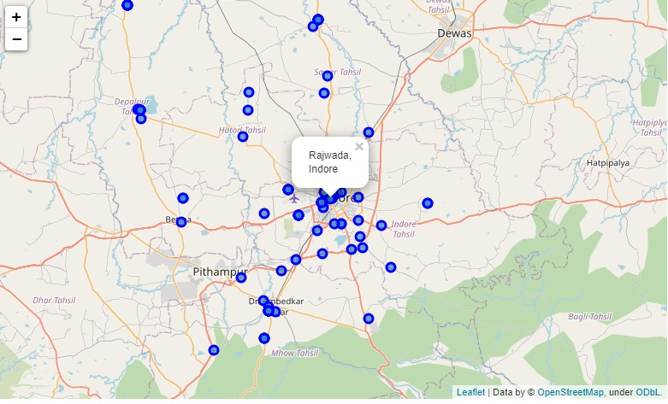
Map Created using the dataset:-

Slide 6
3. Methodology Section
Clustering Approach: To compare the similarities of two cities, I decided to explore neighborhoods, segment them, and group them into clusters to find similar neighborhoods in towns and cities like Indore and Depalpur. To be able to do that, we need to cluster data which is a form of unsupervised machine learning: k-means clustering algorithm.
Work Flow: Using credentials of Foursquare API features of near-by places of the neighborhoods would be mined. Due to http request limitations the number of places per neighborhood parameter would reasonably be set to 100 and the radius parameter would be set to 500.

Slide 7
The Location:
Indore is the most populous and the largest city in the Indian state of Madhya Pradesh.It serves as the headquarters of both Indore District and Indore Division. It is also considered as an education hub of the state and has campuses of both the Indian Institute of Technology and the Indian Institute of Management.The city is distributed over a land area of just 530 square kilometres (200 sq mi), making Indore the most densely populated major city in the central province. It comes under Tier 2 cities in India.
Foursquare API: This project have used Four-square API as its prime data gathering source as it has a database of millions of places, especially their places API which provides the ability to perform location search, location sharing and details about a business.

Slide 8
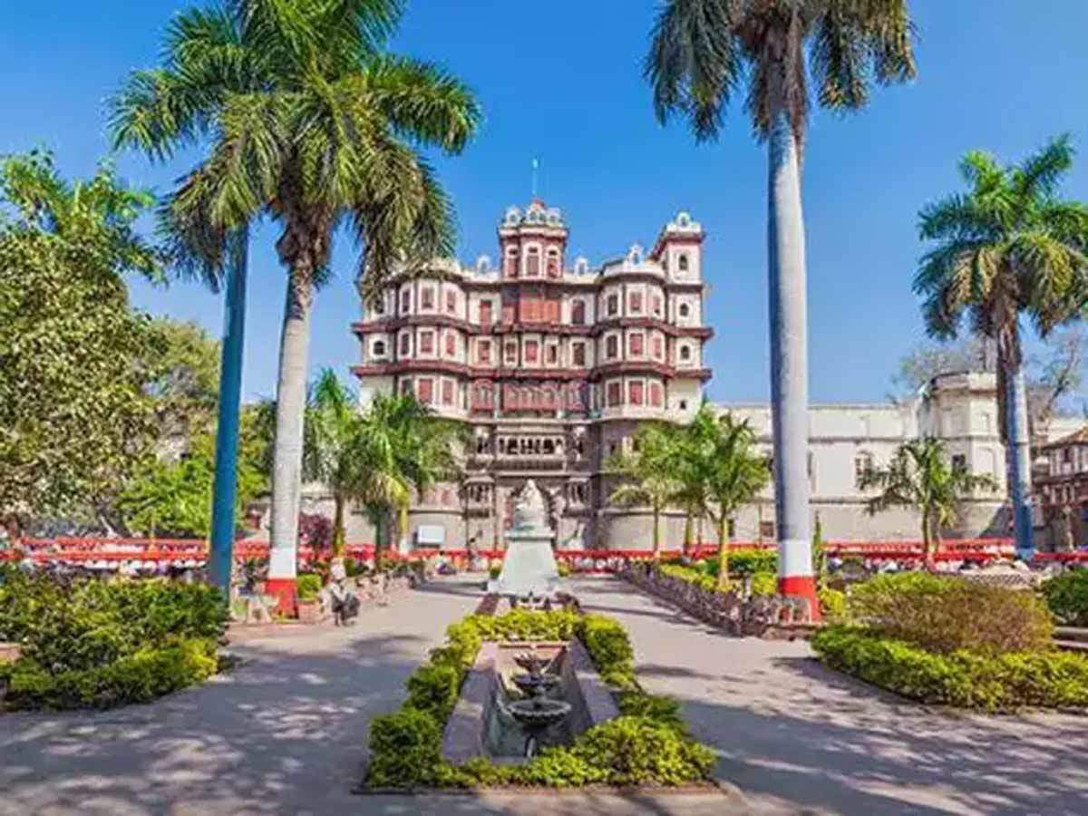
Indore :-

Slide 9
5. Discussion Section
Problem Which Tried to Solve: The major purpose of this project, is to suggest a better neighborhood in a new city for the person who are shifting there. Social presence in society in terms of like minded people. Connectivity to the airport, bus stand, city center, markets and other daily needs things nearby.

Slide 10
6. Conclusion Section
In this project, using k-means cluster algorithm I separated the neighborhood into 5 different clusters and for 189 different lattitude and logitude from dataset, which have very-similar neighborhoods around them.
I feel rewarded with the efforts and believe this course with all the topics covered is well worthy of appreciation. This project has shown me a practical application to resolve a real situation that has impacting personal and financial impact using Data Science tools. The mapping with Folium is a very powerful technique to consolidate information and make the analysis and decision better with confidence.

Slide 11
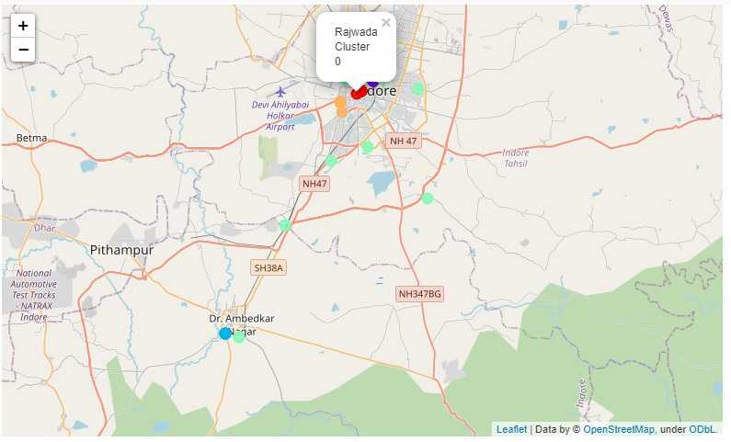
This is the map that i have created to show the resultant clusters

Slide 12
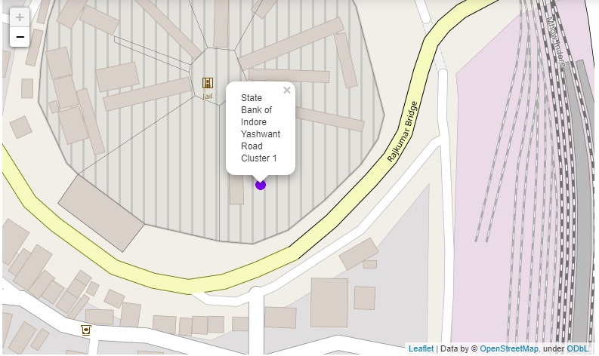
Zoomed cluster:

Slide 13
Future Works:
This project can be continued for making it more precise in terms to find best house in Indore. Best means on the basis of all required things(daily needs or things we need to live a better life) around and also in terms of cost effective.

Slide 14
Libraries Which are Used to Develope the Project:
Numpy: Library to handle data in a vectorized manner
Pandas: For creating and manipulating dataframes.
Folium: Python visualization library would be used to visualize the neighborhoods cluster distribution of using interactive leaflet map.
Scikit Learn: For importing k-means clustering.
JSON: Library to handle JSON files.
Geocoder: To retrieve Location Data.
Beautiful Soup and Requests: To scrap and library to handle http requests.

